Slide 1

NHS England immunoglobulin commissioning update
Mandy Matthews, Commercial Development Pharmacist, Commercial Medicines Directorate
13th December 2019
NHS England and NHS Improvement

Slide 2

This Photo by Unknown Author is licensed under CC BY-SA-NC
2 l NHS England and NHS Improvement
Notes:
Use proforma on table to capture questions and comments throughout.

Slide 3
Achievements to date
21 Sub-Regional Immunoglobulin Assessment Panels (SRIAPs) now in place and making real progress with improving over-arching Ig stewardship
Use of 1g/Kg Ig in ITP has been achieved in 80% of cases treated
Guidelines review
  Updated and circulated November 2019 (haematology, immunology, infectious diseases and neurology)
Development and testing of the electronic Ig-referral form
Development of the FutureNHS Collaborative Ig platform
Notes:
Updated guidance – covers approx. 75% of Ig use; recent update provides clarity regarding prior approval and inclusion of new commissioning policy (Ig in Allo-immune neonatal haemochromatosis & Gestational allo-immune liver disease); updates to ID section including link to PHE health protection teams and dose in measles)
Reviewing use of Ig in existing patients – e.g. with SAD who didn’t meet eligibility criteria – considering cessation of treatment with review and restarting as necessary.
Suggested reduced trend in Ig usage

Slide 4
In progress
Guidelines review
Phase 2: Review of use in “other” indications – available evidence; link with clinical colleagues; updated based on feedback prior to wider stakeholder consultation (expected mid-December to early January); current guidance will have this added plus current grey table so all in one place
Phase 3: Evidence review of grey indications (to include emerging indications)
How to consider use of alternative treatments, e.g. rituximab
Notes:
Reviewing use of Ig in existing patients – e.g. with SAD who didn’t meet eligibility criteria – considering cessation of treatment with review and restarting as necessary.
Suggested reduced trend in Ig usage

Slide 5
In progress
Individual Funding Requests (IFRs)
Audit – via regions, IFR team and MDSAS database
Proposal that all listed greys are to be considered by SRIAPs, rather than those with little or no evidence being submitted as an IFR
  SRIAP would need to consider:
    Not routinely commissioned
    Available evidence
    Does the evidence support the request
    If not, request should not be approved
Policy decisions required for non-listed greys – phase 3 guidance work
Notes:
Recent concerns raised by Panels re IFRs being screened out; role of experts; workload; variation
What is the extent of the problem – audit
Circular being developed
Proposal will not solve requests for non listed requests – phase 3 of the guidance work – identify emerging conditions; evidence review, policy development where evidence supports
Aware that sometimes expert advice is received in a request for use outside of guidance – is this a problem? How handled? Is a 2nd opinion requested – use proforma to capture comments

Slide 6
In progress
Ig-referral system
Phase 1 pilot: two SRIAPs testing the system to confirm concept
Phase 2 pilot: additional SRIAPs; extending to all trusts within a SRIAP
Updates to the system based on initial feedback – version 1.5
Phase 3: roll out to all trusts
How to embed the system in to local processes
Sharing best practice
Developing core principles to support SRIAPs, built on current Terms of Reference and KPIs and to include learnings from phase 1 and 2 testing
Notes:
Data set to support validation against core principles

Slide 7
Subcutaneous Immunoglobulin (SCIg)
Some additional SCIg available
Consider for both existing and new patients as appropriate
Over-sight by SRIAP
Confirm stock availability with company, who will inform CMU of any changes
Notes:
Data set to support validation against core principles

Slide 8

Learning Curve
National Immunoglobulin Database Meeting
London - 13th December 2019
Southwest SRIAP
Christine Symons & Susan Marett

Slide 9

Starting out
Job description
Venue & Equipment (space!)
Timetable – to fit with established clinic commitments across the panel members.
Process for dealing with referrals and responses.

Slide 10

Once Established
Purpose of SRIAP
Identifying the purpose and communicating this to Spoke Trusts
Keeping Track
    5 Trusts within Southwest SRIAP
Processes
    StIg
    Non engagement
    Pharmacy SOP
    DPIA (Data Protection Impact Assessment)
Appeals Process
    Established panel for second opinion request

Slide 11
Process for existing Ig usage.
Patient identified by trust* as due annual review.
Consultant responsible for patient care advised that long term form needs completion for panel.
Panel advised by trust* that patient due for review.
If completed form not forthcoming, this will be chased up once by SRIAP coordinator for next appropriate panel meeting.
Panel outcome communicated to consultant and trust
Target = by 2 weeks of panel decision. (this may not always be achieved due to leave but coordinator able to provide informal indicative outcome by phone/email if urgent and on enquiry made by referring consultant.)
If approval granted funding continues until review date advised by panel when further review form will be required to panel
If approval not given funding ceases from the date of the panel meeting.
  * this may be whoever is responsible for authorizing and dispensing Ig within the trust.

Slide 12
Form NOT received by panel following identification of review date
Reminder letter/ email sent to relevant consultant at 1month from original panel date. (letter 1)
If no form received further reminder sent and copied to medical director at 2 months from original date. (Letter 2)
If no form received, letter stating funding ceased sent to consultant, service lead, pharmacy, medical director and commissioner at 3 months from panel date. (Letter 3)
If referrals to panel are overdue but eventually received and approved within the three month period funding continues unbroken.
If no referral is received to panel after the three month grace period then funding ceases from the time of the original panel review date.
Form received but with incomplete information and panel unable to make a decision.
Letter sent to referring consultant asking for further information and specifying where possible what is required.
Panel discussion deferred to meeting in 4 weeks.
If no further information is received process above followed as if no form as been received beginning at the original panel date.

Slide 13
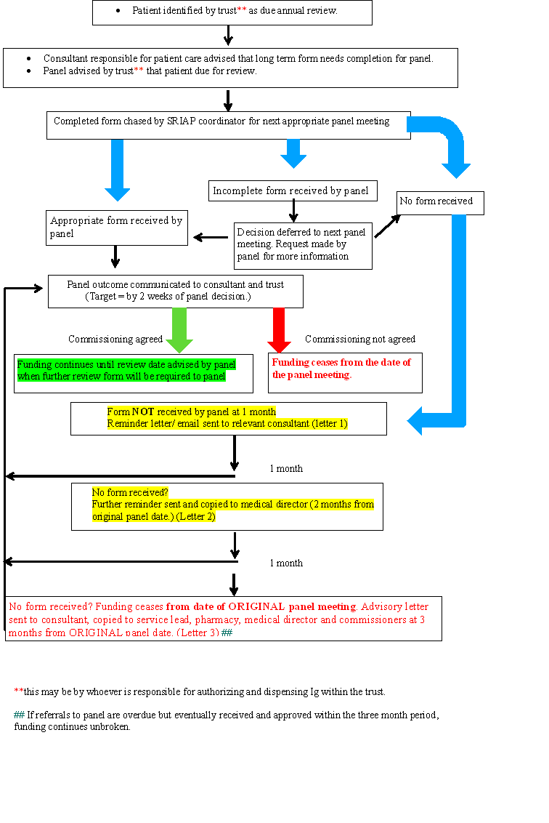
SRIAP Process Flow Chart

Slide 14
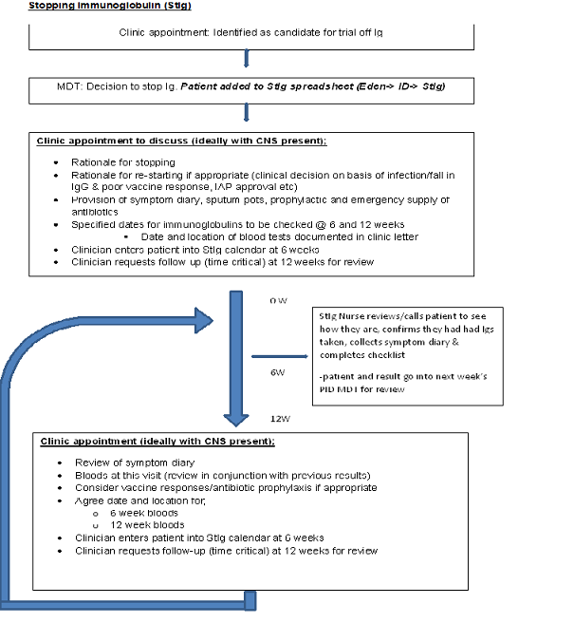
Trail Off Immunoglobulin Flow Chart

Slide 15

End of year 1
What we have learnt
Demonstrated awareness of usage
Quality of completed forms improved with sufficient information for the panel to be able to make a decision.
Encouraged closer monitoring of dosage and use of ideal body weight
Encouraged use of appropriate outcome measure.
Following commissioning guidance

Slide 16
SRIAP Systems
East of England Immunoglobulin Assessment Panel

Slide 17
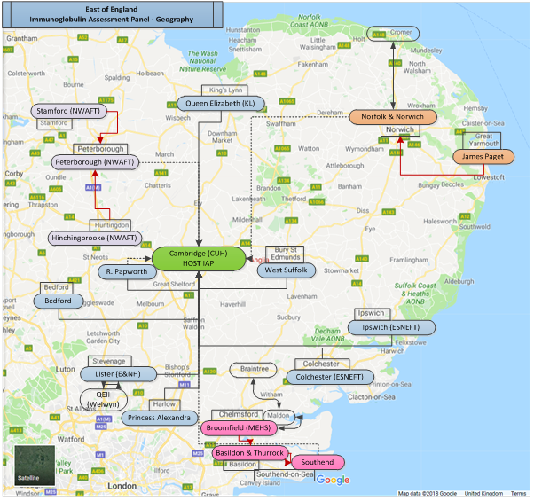
The East of England IAP
14 Trusts
28 Hospitals
Host = CUH
  24 clinicians
746kg Ig p.a.

Slide 18
Process of prescribing
Patient requires immunoglobulin
Prescribing guidance

Slide 19

Patient on ward requires treatment
Clinical Guideline
  Eligibility
  Panel approval (Y/N)
  Dose
  Out of hours (Y/N)
This Photo by Unknown Author is licensed under CC BY-NC

Slide 20

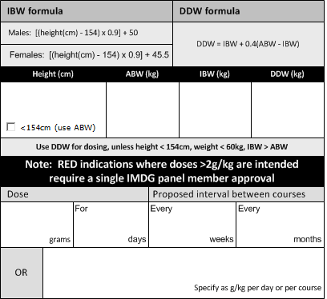
Dose determining weight
https://rebrand.ly/EOEIAP

Slide 21
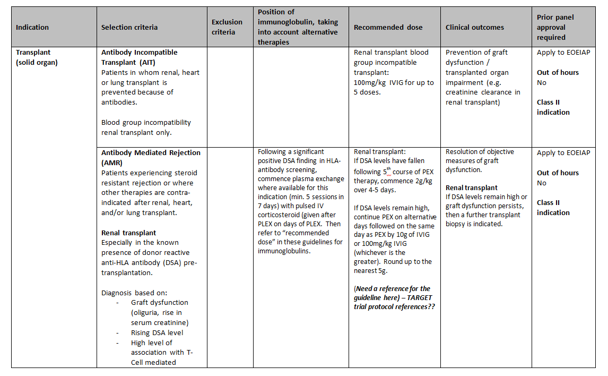
Insert extract from the regional guidelines here

Slide 22
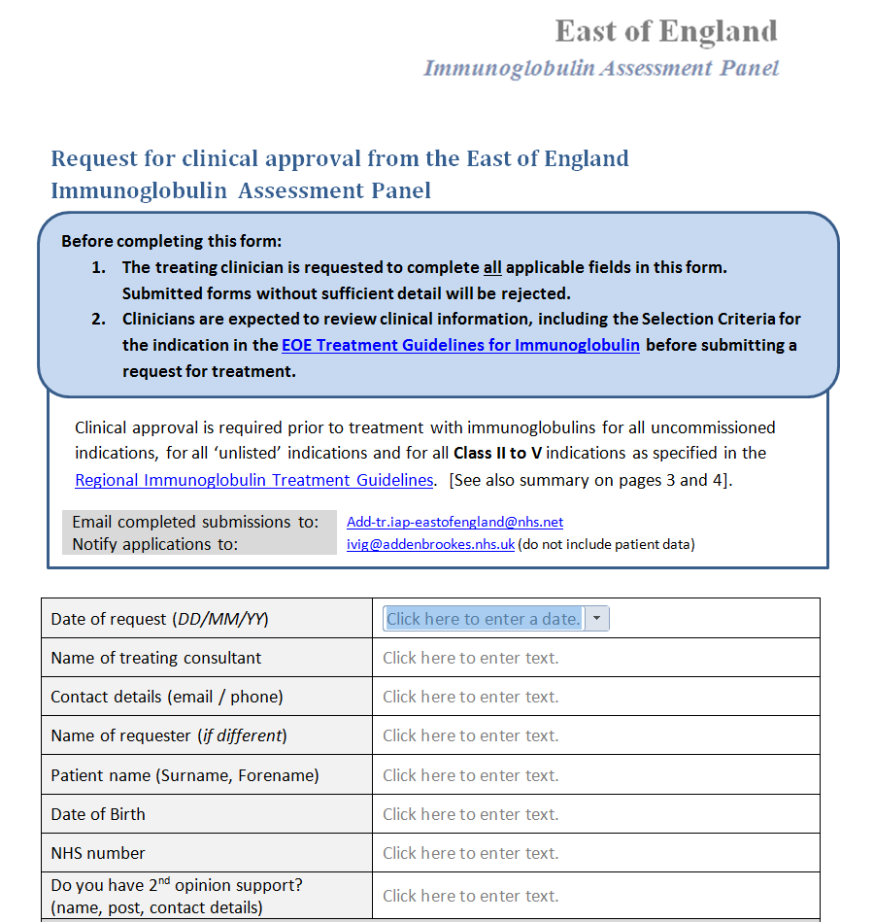

Slide 23
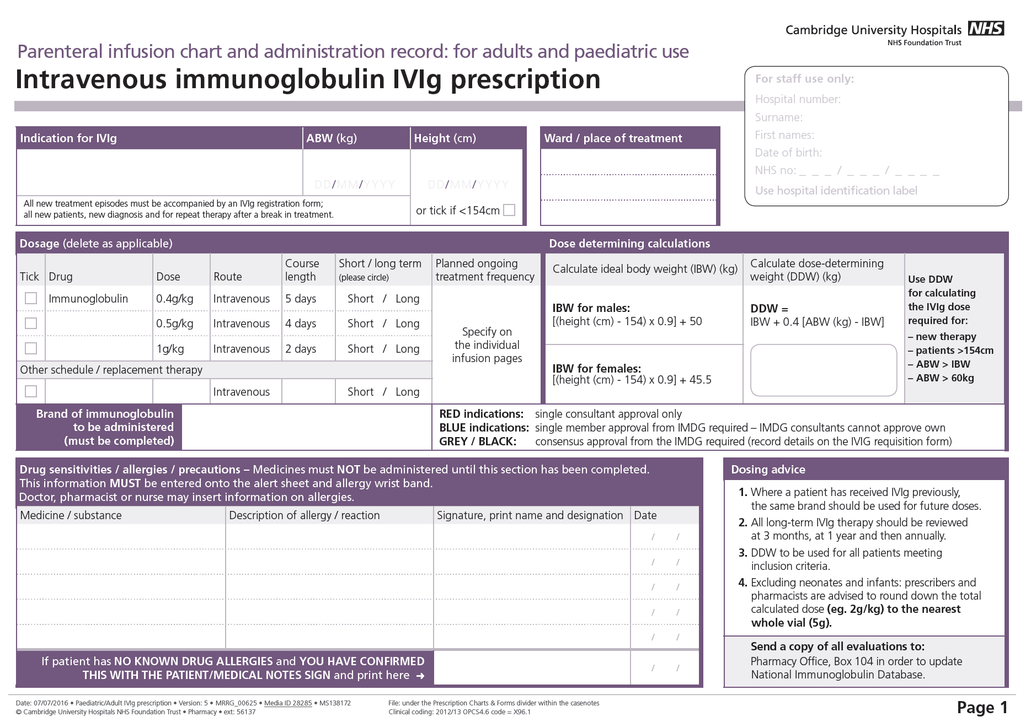

Slide 24
Mechanism for approval
Patient requires immunoglobulin
Prescribing guidance
Panel approval

Slide 25
Patient on ward requires treatment
Application to panel
  Virtual panel < 24 hours
  Specialist panel Weekly
  Regional panel Monthly
  add-tr.iap-eastofengland@nhs.net (associates)
  ivig@addenbrookes.nhs.uk (CUH)

Slide 26
Approval – per indication
Class I – Life or limb indication
  Out of hours treatment permitted
Class II – Strong clinical evidence in selected patients
  Panel approval required
Class III – Former GREY commissioned
  Consensus panel approval
Class IV – Former GREY uncommissioned & unlisted.
  Requires consensus panel approval & NHSE funding approval.
Class V – No clinical evidence

Slide 27

Complete / submit application form

Slide 28
Process of prescribing
Patient requires immunoglobulin
Prescribing guidance
Panel approval
The Patient

Slide 29
Patient on ward requires treatment
Provide patient information leaflet (EOEIAP)
  Why immunoglobulin
  Side effects
  Blood product risks
  Sharing of patient data – with panel and database
Undertake consent (local process)
Review VTE risk assessment

Slide 30
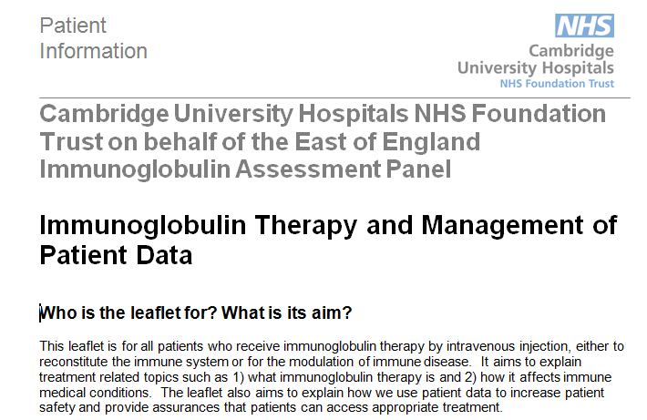
Underpinned by
PIL

Slide 31
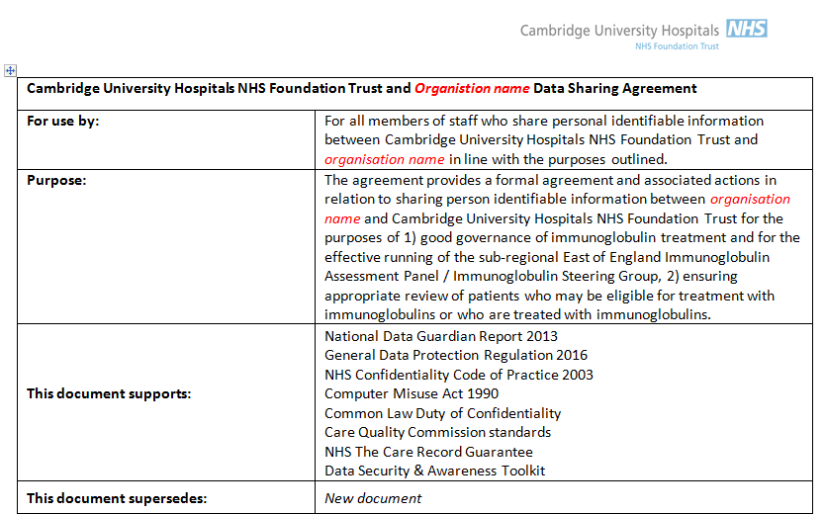
Underpinned by
Data Sharing Agreement

Slide 32
Monitoring
Patient requires immunoglobulin
Prescribing guidance
Panel approval
The Patient
Follow up

Slide 33

https://www.cuh.nhs.uk/sites/default/files/misc/EoE_IAP_CorePracticeStandards_1.pdf

Slide 34
Core Practice Standards
Abide by decisions
Clinical approval
Report outcomes
Notify all use of Ig
No delayed or cancelled Tx
Participate in regional panel
Data sharing
Patient consent
Regional documentation
Batch numbers
Out of hours Tx
Standard dosing
Standard exceptions
Response to requests for data
Ig allocations managed by SRIAP

Slide 35
Regional principles
Universal dosing standards
Data sharing
All treatment → authorised centrally
Every patient with reported outcomes
All allocation is coordinated by the IAP
All underwritten by medical directors

Slide 36
Engagement

Slide 37
SRIAP allocation monitoring
Purchasing
  End of month
  Hospital
  Manufacturer
Reallocate
  Within region

Slide 38
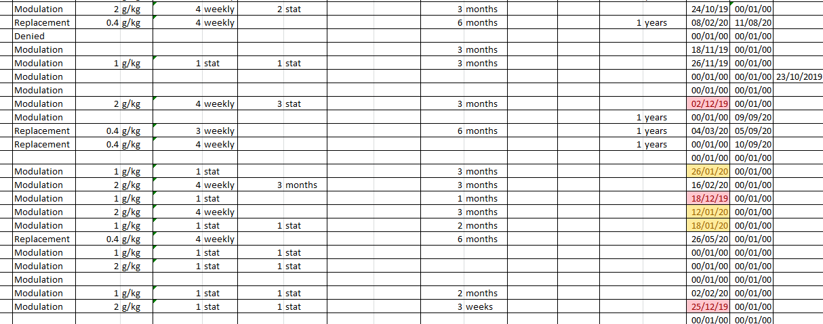
Tracking outcome measures

Slide 39
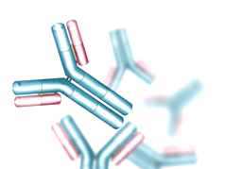
Daniel Clarke
UHNM Sub-Regional Assessment Panel
Review and Audit of Existing Patients
Notes:
Debbie

Slide 40


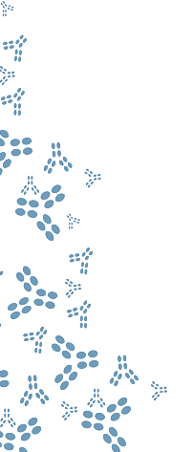

Where is Stoke?
Owestry
(RJ&AH)
Stoke
(UHNM)
Stafford
(MPFT HQ)
Shrewsbury
(SATH)
Wolverhampton
(RWT)
Walsall
Dudley
(DGFT)
Birmingham
Sandwell
(SWB)
Manchester
Sheffield
Liverpool
Nottingham
Stoke
Leicester
Birmingham
Oxford
Cardiff
Bristol
Notes:
Debbie

Slide 41


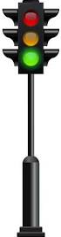
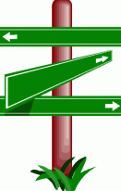
The Road to Panel Formation…
February 2019 – First SRIAP meeting
August 2018 – UHNM TEC approved Action Plan as complete.
April 2018 – Development of local Executive letter, Action Plan and update of Risk Register
October 2018 – UHNM appointed SRIAP
March 2018 – NHSE declare national shortage of HNIG and request urgent action
July 2017 – 17/18 CMU Framework
Notes:
Dan

Slide 42
The Road to Panel Formation…
UHNM actions in response to National Shortage demonstrated reduction of HNIG usage in 18/19
  25% reduction from baseline, cost avoidance of ~£580,000
  31% reduction from projected growth, cost avoidance of ~£825,000.

Slide 43
The Road to Panel Formation…
NM Sub-Regional Panel responsible for HNIG stewardship over 7 Trusts
  18/19 total usage estimated at 160kg
  Projected use for 19/20 = 201kg
First Request 4th February 2019
First Meeting 15th February 2019

Slide 44
Panel Structure
Neurology
Haematology
Paediatrics
Rheumatology
Independent Chair
Obstetrics
Immunology
Pharmacy
Renal

Slide 45
Panel Functions
“Urgently establish effective clinical leadership via Sub Regional IAPs in order to focus on demand management through effective clinical stewardship of the limited availability of immunoglobulin supplies.”
Review all requests for new patients
  201 requests; 146 external (Feb-Nov 19).
  16 requests rejected.
Develop audit programme.

Slide 46
Audit Timeline

Slide 47
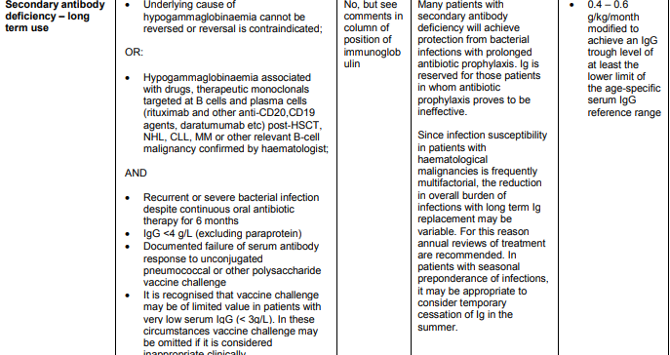
Secondary Antibody Deficiency Audit
UHNM May 2018 Audit:
  13 Patients trialled off HNIG; 0 patients retreated
Regional Audit Standards:
  Patient to have received antimicrobial prophylaxis for >6 months
  IgG level <4g/L
  Patient to have received antimicrobial prophylaxis for >6 months and IgG level <4g/L

Slide 48
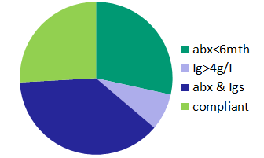
Secondary Antibody Deficiency Audit
…..The results of the Regional Audit
86 patients identified to be receiving HNIG for secondary antibody deficiency
25% of patients compliant with January 2019 Updated Clinical Commissioning Guideline criteria
At UHNM: 23 patients have been trialled off HNIG therapy; 1 patient retreated, 0 Hospital admissions.
Notes:
58% of patients now have Ig in normal range after stopping >4 months

Slide 49
Impact of Panel
18% reduction from 18/19 average monthly usage
  ~2.3kg per month; 27.6kg per annum
  ~£80k per month; £960k per annum
32% reduction from projected 19/20 monthly usage
  ~3.6kg per month; 43kg per annum
  ~£127k per month; £1.5 million per annum

Slide 50

Lessons Learned….

Slide 51
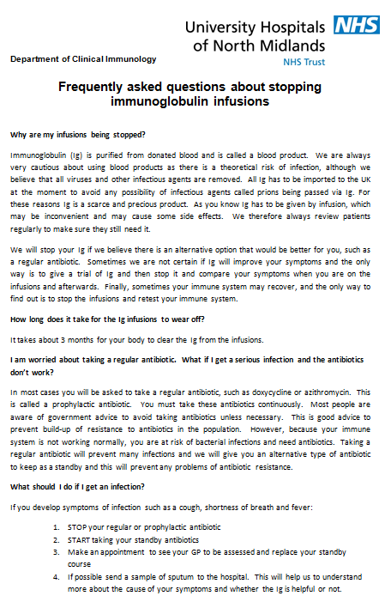
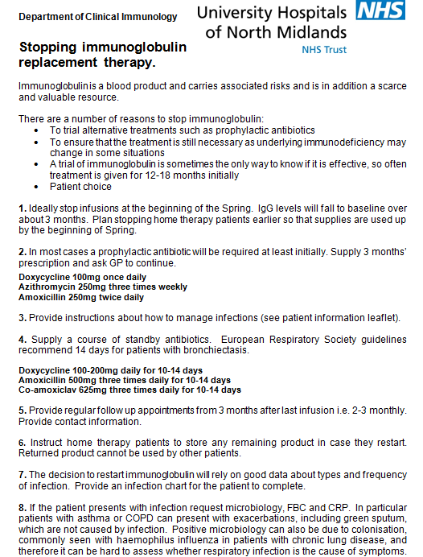
…What Went Well
Reduction in HNIG consumption
Local patient communications
  Letters
  FAQ
  Direct
Patient satisfaction
Local immunology support for clinics
Notes:
Debbie (& Dan)

Slide 52
…And What Went Not So Well!
Clearer advance notification of audit brief
  Implications
Tracing trust compliance with recommendations
Selection of Homecare patients
Us vs. We….
  Consistency of local clinical support across the region
  Shared regional/national support documents
Notes:
Debbie (& Dan)

Slide 53
Thank
You!
Notes:
Debbie

Slide 54
New patient review, Communication, MDSAS data recording
Immunoglobulin Database Meeting, London. 13Dec19
Nigel Watson, member of West Yorkshire SRIAP
Notes:
Previous presentations by people closely involved in co-ordinating SRIAP in their area.
West Yorkshire co-ordinator not able to attend, so I volunteered to give a presentation from the perspective of a local panel member of the group. I am not involved in running the SRIAP.
There will be time for any questions in the next part of the session. But feel free to catch me afterwards if there are any questions you might have.

Slide 55
West Yorkshire SRIAP
Covers six acute hospitals. Hosted by Leeds
Local IAPs still in place
SRIAP has governance / oversight of IAPs
450 ‘long term’ patients
SRIAP in place since end Mar19
Notes:
Hosted by Leeds Teaching Hospitals NHS Trust
Airedale NHS Foundation Trust
Bradford Teaching Hospitals NHS Foundation Trust
Calderdale & Huddersfield NHS Foundation Trust
Harrogate & District NHS Foundation Trust
Mid Yorkshire Hospitals NHS Trust (Wakefield)
Initially met every 6 weeks, but now planned for every 8 weeks
Each trust still has its local panels in place. Local IAPs still make decisions regarding all new patient requests but SRIAP has oversight of new patients starting on immunoglobulin.
Terms of reference for SRIAP also include
Appeals from local IAP can be made
Review appropriateness of all immunoglobulin IFRs before submitting to NHSE (none as yet)
There are currently 450 long term patients on immunoglobulin treatment. [About 40 ‘long term’ started in Q1 and Q2 of 19/20. Short term ~100 new starters in Q1 and Q2]
SRIAP has been in place since end of Mar19. So far have met on five occasions. As you’d expect, detailed minutes recording and following up agreed actions is fundamental to the efficient operation of the SRIAP.

Slide 56
New patient review
Reviewed quarterly
100% new immunoglobulin patients reported on template (MDSAS data)
New patients reviewed retrospectively
  All greys; 20% blues
Q1 review – letter to local Trust giving feedback
Notes:
Possible difference in approach to other SRIAPs.
Reviewed quarterly. Q1 review has been documented in the minutes. Q2 review happened last week due to the dates of meetings (previous meeting just before end of Q2)
Use the MDSAS data as basis for the template. Individual trusts add dose, frequency of administration and patient weight .
Focussing in on the long term patients. All the grey indication patients reviewed. 20% of blue patients reviewed.
18 patients reviewed in Q1 and Q2. [Q1 – B=3; G=4. Q2 – B=5; G=6]. Grey patients receiving SCIg for tetanus prophylaxis not formally presented. Totals B=8; G=10.
39 long term new starters in Q1 and Q2. Red = 10; Blue = 28; Grey = 1.
101 short term starters in Q1 and Q2. Red = 62; Blue = 17; Grey = 22
As a result of the Q1 review, letter sent from SRIAP chair to local trust (Medical director and IAP chair) documenting issues raised by SRIAP. Request for feedback from IAP to be presented at next meeting.

Slide 57
New patient numbers – Q2
Trust | Total | Red | Blue | Grey | Short term | Long term
1 | 5 | 3 | 1 | 1 | 5 | 0
2 | 10 | 6 | 3 | 1 | 7 | 3
3 | 14 | 5 | 2 | 7 | 13 | 1
4 | 1 | 0 | 1 | 0 | 1 | 0
5 | 42 | 23 | 15 | 4 | 27 | 15
6 | 7 | 3 | 4 | 0 | 3 | 4
TOTALS | 79 | 40 | 26 | 13 | 56 | 23

Slide 58
New patient review cycle
Quarterly report
Local data added
Identify patients to review
Present at SRIAP. Discussion
SRIAP response to Med.Director
Review template completed
Notes:
RED - Quarterly report
Requested to be produced by MDSAS
GREEN - Local data added
Co-ordinator sends to trust pharmacy contact
Extra data added
Dose, frequency, weight
Whether patient has previously been treated with Ig for the same indication
Returned to co-ordinator
PURPLE - Identify patients to review
Co-ordinator highlights which patients will be reviewed for each trust
20% blue patients
All grey indication patients
Returned to trust contacts
BLUE - Review template completed (blank example on next slide)
Summary of the patient details
This is presented at SRIAP meeting. Details discussed / challenged
ORANGE / RED - SRIAP response to medical director
Any comments or recommendations made by SRIAP are fed back to Trust medical director and Chair of IAP
Invite to next SRIAP meeting for response to comments and to update on any actions which were identified by SRIAP

Slide 59
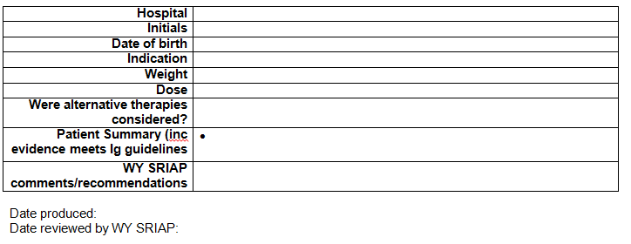
Patient review template

Slide 60
Communication – Q1 examples
Treatment not in line with guidance
Local approval process challenged
Baseline measures not included on request from
Second dose appropriateness
Appropriate use
Funding stream clarification
Notes:
These are some Q1 examples of feedback from the SRIAP to local trust
Dermatomyositis (blue long term)
Noted that patient should have received rituximab prior to immunoglobulin. Not in line with current guidance
Panel specialty member approved request from within their own specialty. IAP asked to review this practice
Myasthenia Gravis
No baseline measurements included on the request form
IAP reminded these are essential to ensure use is in line with current guidance and provides assurance this is being followed
2g/kg used for one MG patient instead of 1g/kg (updated guidance)
Autoimmune encephalitis
One patient received 2 doses. Was 2nd dose approved by local IAP? What was rationale for 2nd dose?
Discussion that 2nd dose may be useful if antibody levels increasing
There was a second patient being treated for this indication where use was appropriate, so no further comments
Neuromyelitis Optica
NHSE attendee opinion that funded via Walton Centre and Oxford. Charges to be passed on to commissioning centre if treatment approved
Funding stream needs clarification

Slide 61
Using MDSAS data
Information download from MDSAS database
Identify patients for quarterly review
Identify progress with outcome measures and follow up recording – CQUIN
Missing parameters – NHS number / Consultant
Notes:
Data for SRIAP downloaded by MDSAS as not available as a standard report. However, there are a plethora of reports available which are useful for trusts.
MDSAS data used as a basis to produce
New patient list (already discussed) for the quarterly review
Identify progress / areas of concern with follow up recording and outcome measures for CQUIN
WYSRIAP progress for follow up and outcome reporting has improved (slightly) between Q1 and Q2 for ‘all patients’ and ‘neurology’ patients – 18% to 30% and 7% to 25% respectively.
Data still needs some manipulation as some parameters not yet included in the report. Hoping this will be resolved

